Slide 1
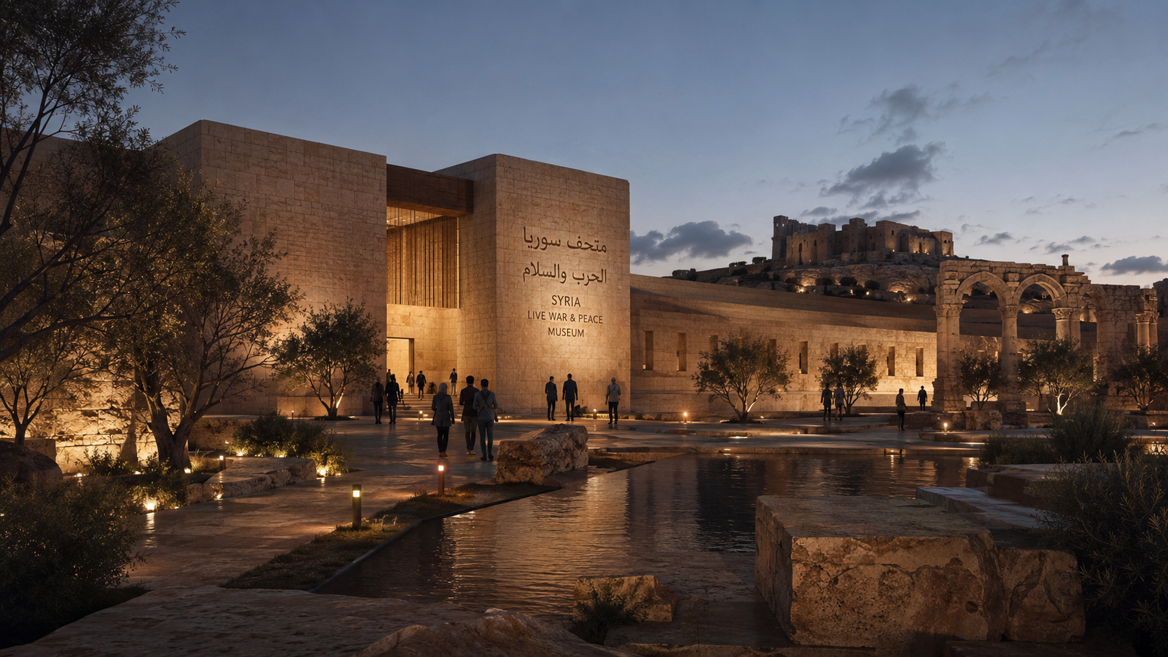
GOVERNMENT CONCEPT PROPOSAL | SYRIA
Syria Live War Museum
A world-class museum of memory, humanity and peace — connected to smart city development, tourism, jobs and national recovery.
Remember the Past • Build Peace • Rebuild the Future
Syria Live War Museum + Syria Smart City Development Program
Concept Presentation | Prepared for discussion with Government of Syria and strategic partners
01

Slide 2
01 | PROPOSAL SUMMARY
Executive Positioning
This is not a museum to celebrate war. It is a national platform to preserve memory, honour people, teach peace and support rebuilding.
Core positioning statement
Flagship Museum
Museum Network
A landmark “live” war and peace museum combining preserved sites, immersive storytelling, digital archives, education and remembrance.
3 to 4 museum locations across Syria, with the first and largest positioned as a global destination for remembrance and peace tourism.
Smart Cities
Country Program
2 to 4 planned smart cities near selected development zones, scaled as 10×10 km, 20×20 km or 30×30 km based on feasibility.
A wider national development program combining housing, infrastructure, investment, jobs, tourism, heritage and public services.
Concept Presentation | Syria Live War Museum + Smart City Development Program
02

Slide 3
02 | STRATEGIC CONTEXT
Why This Project Matters Now
Syria’s recovery needs more than construction. It needs memory, trust, jobs, investment, tourism and a visible national vision.
Memory & dignity
Peace education
Economic recovery
Create a place where Syrian stories are preserved with respect, without political glorification or exploitation.
Teach future generations and international visitors the human cost of conflict and the value of peace.
Turn heritage and remembrance into tourism, investment, construction, skills, SMEs and long-term employment.
The proposal connects a humanitarian museum with smart city development so remembrance becomes a platform for national rebuilding, not only a visitor attraction.
Concept Presentation | Current context to be validated through official feasibility and due diligence
03

Slide 4
03 | EVIDENCE CONTEXT
Syria Today: Recovery Imperative
Available public assessments show the scale of damage and the urgency of coordinated recovery.
$108B
$216B
48%
3
Direct physical damage to infrastructure, residential and non-residential buildings assessed by the World Bank.
Conservative best estimate for post-conflict reconstruction costs of damaged physical assets.
Infrastructure accounted for the largest share of direct assessed damage.
Aleppo, Rif Dimashq and Homs were among the most severely affected governorates by total damage.
World Bank, 2025
World Bank, 2025
World Bank, 2025
World Bank, 2025
Project implication
Strategic opportunity
The first flagship museum and development zone should be selected through a transparent feasibility process that considers damage intensity, heritage value, safety, available government land, climate, access, utilities, and community benefit.
A museum-led development program can become a visible symbol of recovery while attracting responsible investment, tourism, skills and international partnerships.
Sources summarized in final slide
04

Slide 5
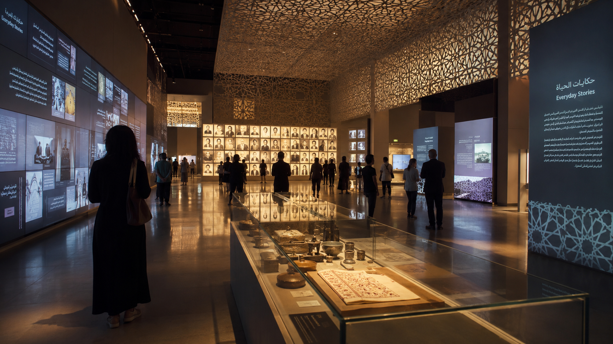
VISION
From War Memory to Peace Economy
The project transforms damaged memory into a dignified national platform for education, tourism, employment and reconstruction.
01
Remember
02
Educate
03
Heal
04
Rebuild
Preserve stories, archives, sites and personal memories.
Teach the cost of war through immersive, truthful experiences.
Create spaces for families, youth, reflection and reconciliation.
Link museum districts to smart city, jobs, investment and services.
Concept Presentation | Syria Live War Museum + Smart City Development Program
05

Slide 6
04 | MUSEUM CONCEPT
What the Syria Live War Museum Is
“Live” means immersive, living memory — not live conflict.
A museum of memory
A peace education platform
A heritage restoration hub
Collects, preserves and presents stories of families, cities, schools, hospitals, heritage and communities affected by war.
Uses guided experiences, school programs, VR/AR, documentaries and survivor testimony to teach “never again.”
Supports protection, documentation and restoration of cultural sites, artifacts and damaged historical assets.
A tourism landmark
A social impact engine
A national rebuilding symbol
Creates a dignified visitor destination connected to hotels, events, conferences, cultural routes and local businesses.
Links ticketing, donations and partnerships to support families, youth training, SMEs and community recovery.
Connects remembrance with modern, sustainable smart city development and public services.
Concept Presentation | Syria Live War Museum + Smart City Development Program
06

Slide 7
05 | HUMANITARIAN POSITIONING
Museum Principles
The museum must be safe, respectful, neutral and human-centered.
1
No glorification of war
2
Human dignity first
The tone must be remembrance, learning and peace — never entertainment from suffering.
Victims, families and communities are represented with consent, care and cultural sensitivity.
3
Truthful documentation
4
Inclusive national memory
Archives, oral histories, exhibits and data should follow professional curatorial and ethical standards.
The museum should serve all Syrians and all visitors, with non-political humanitarian positioning.
5
Safety and de-mining
6
Local benefit
Any preserved site or “live zone” must be cleared, secured and certified before public access.
Jobs, training, procurement, tourism and community programs must benefit Syrians directly.
Concept Presentation | Syria Live War Museum + Smart City Development Program
07

Slide 8
06 | VISITOR JOURNEY
Flagship Museum: Core Experience Zones
01
Arrival & Peace Plaza
02
Human Stories Gallery
03
Destroyed City Walk
Ceremonial public square, flags, water, trees, memorial wall and welcome center.
Personal stories, family memory, portraits, letters, children’s experiences and oral history.
Safe reconstructed streets, school, clinic, market and home scenes showing what war destroys.
04
Digital War Archive
05
Heritage Recovery Lab
06
Peace & Rebuilding Pavilion
Documentary theater, interactive maps, testimonies, digital records and research library.
Restoration workshops, artifact conservation, training and UNESCO-aligned heritage education.
Future Syria exhibition: smart cities, jobs, housing, investment and national recovery.
Visitor message: “I understand what war destroys. I understand why peace is priceless. I can support Syria’s rebuilding.”
Concept Presentation | Syria Live War Museum + Smart City Development Program
08

Slide 9
07 | NATIONAL FOOTPRINT
Museum Network: 3 to 4 Locations
A national network can distribute tourism, memory and jobs across regions while keeping one flagship museum as the global landmark.
01 | Flagship Live War & Peace Museum
Largest destination; immersive experience; peace plaza; archive; conference center; smart city gateway.
02 | Northern Heritage & Reconstruction Museum
Focus on damaged old cities, markets, schools, hospitals and heritage recovery.
03 | Central Syria Memory Museum
Community memory, displacement, family stories, youth training, SME marketplace.
04 | Heritage Route / Desert Peace Museum
Optional site connected to ancient trade routes, Palmyra-style heritage recovery and international tourism routes.
Final locations must be selected with the Government of Syria after land, security, environmental, heritage, transport and community-benefit studies.
Concept Presentation | Syria Live War Museum + Smart City Development Program
09

Slide 10
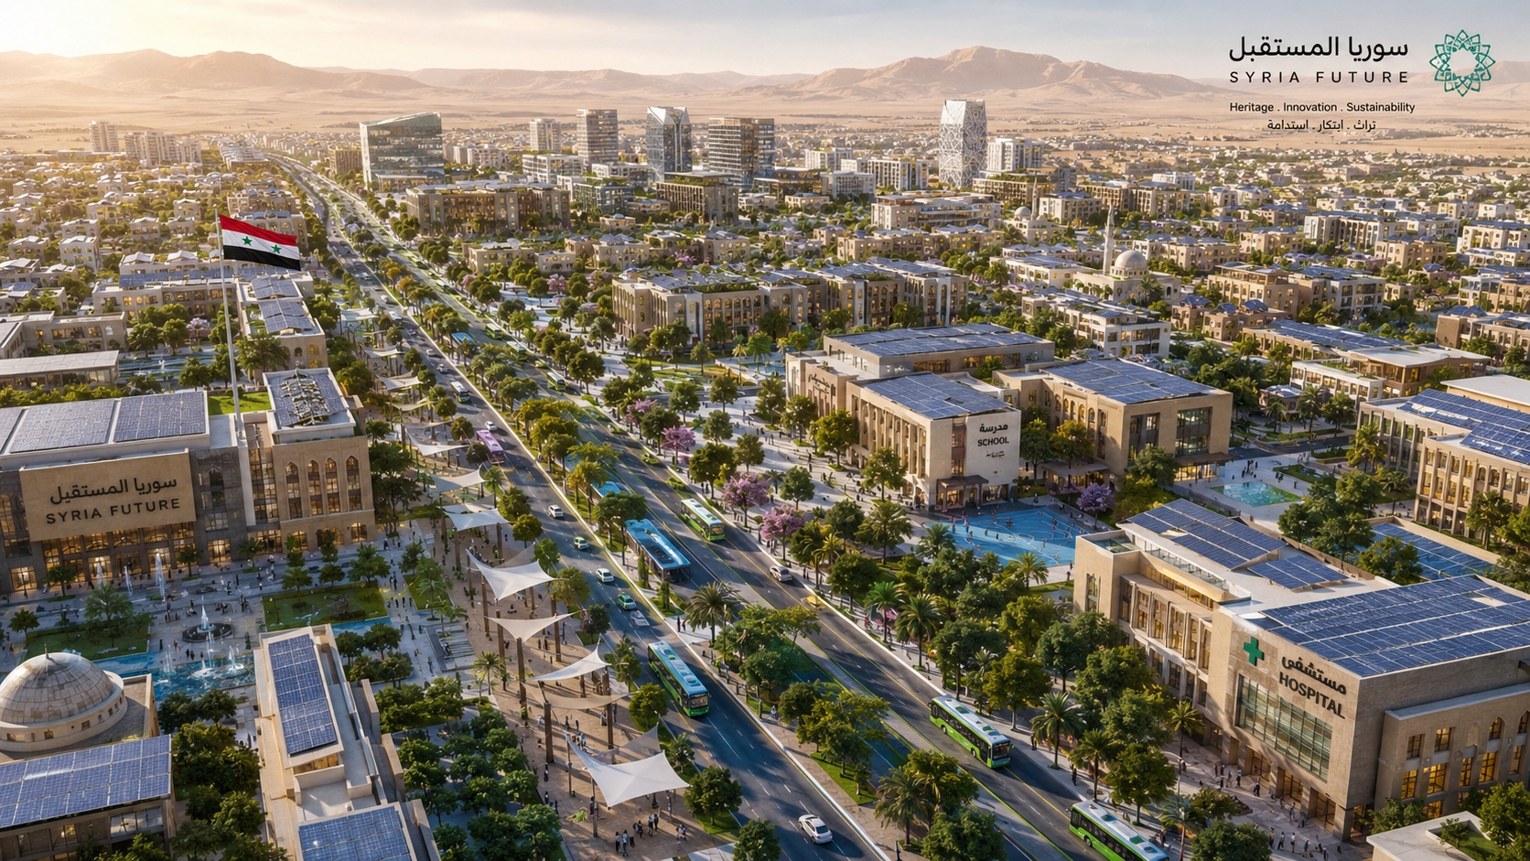
SYRIA SMART CITY DEVELOPMENT PROGRAM
Rebuilding with Planned, Smart, Livable Cities
The museum is the emotional gateway. The smart cities are the practical engine for housing, services, investment, jobs and national development.
Housing & community
Solar and utilities
Smart mobility
Hospitals & schools
Tourism & retail
Industrial & SME zones
Concept Presentation | Syria Live War Museum + Smart City Development Program
10

Slide 11
08 | MASTER PLANNING
City Scale Options
Three planning sizes can be evaluated. The final choice should match land availability, infrastructure capacity, security, climate, financing and phased demand.
10 km × 10 km
20 km × 20 km
30 km × 30 km
100 km²
400 km²
900 km²
Pilot smart city / museum district
Regional smart city
National mega development zone
Fastest to phase; suitable for first development zone, housing, tourism services and public facilities.
Allows larger residential, logistics, industrial, education, health and tourism clusters.
Requires multi-phase implementation, strong infrastructure, major financing and long-term governance.
Concept Presentation | Syria Live War Museum + Smart City Development Program
11

Slide 12
09 | PROGRAM DESIGN
Smart City Development Components
Residential districts
Utilities platform
Tourism economy
Affordable, resilient housing with public spaces, community services and smart maintenance.
Solar generation, grid upgrades, water treatment, waste management and digital infrastructure.
Hotels, museum retail, cultural markets, conference venues, visitor mobility and guide training.
Education & health
Industrial & SME zones
Digital governance
Schools, vocational institutes, trauma-informed social services and hospitals/clinics.
Construction materials, heritage restoration, crafts, food, logistics, local manufacturing and services.
One-window investment desk, permits, land registry, city services, dashboards and transparent reporting.
Concept Presentation | Syria Live War Museum + Smart City Development Program
12

Slide 13
10 | MUSEUM + SMART CITY
Integrated Development Model
One proposal, three mutually reinforcing engines.
Memory
& Peace
Smart
Infrastructure
Economic
Recovery
Museum, archives, education, memorials, family stories
Housing, utilities, mobility, schools, health, digital services
Tourism, investment, jobs, SMEs, skills, procurement
The museum attracts memory, visitors and attention; the smart city converts attention into long-term national value.
Concept Presentation | Syria Live War Museum + Smart City Development Program
13

Slide 14
11 | DUE DILIGENCE
Location Selection Framework
The project should not choose land only because it is available. It should choose land that is meaningful, safe, developable and beneficial.
Damage & remembrance value
Security & public safety
Areas that clearly communicate the human cost of war while respecting residents and survivors.
Explosive hazard clearance, stable access, emergency services and controlled visitor movement.
Government land & title clarity
Connectivity
Large, legally clean plots enabling PPP development without displacement or ownership conflict.
Road, rail/airport potential, logistics, utilities corridors and tourism route integration.
Climate & livability
Community benefit
Water, topography, heat, wind, flood risk, green planning and long-term operating comfort.
Jobs, housing, local procurement, skills training, social services and SME opportunity.
Concept Presentation | Syria Live War Museum + Smart City Development Program
14

Slide 15
12 | GOVERNMENT OFFER
What We Propose to the Government of Syria
1
Approve a concept MoU
Authorize a joint feasibility pathway for the museum network and smart city development zones.
2
Create a task force
Government + project sponsors + heritage, tourism, planning, finance, security and community representatives.
3
Shortlist land zones
Identify 3 to 5 candidate areas for flagship museum, satellite museums and 2 to 4 smart cities.
4
Launch feasibility
Prepare DPR, ESIA, heritage assessment, land study, PPP model, investment prospectus and implementation SOP.
5
Mobilize partners
Engage developers, investors, museums, universities, NGOs, tourism operators and donor/recovery partners.
Concept Presentation | Syria Live War Museum + Smart City Development Program
15

Slide 16
13 | TRANSFORMATION STORY
Syria Before and After the Program
Today: Recovery Challenge
Future: Visible Transformation
War memory remains fragmented
Heritage and public buildings need repair
Tourism confidence is weak
Youth need jobs and skills
Cities need planned infrastructure
National landmark for peace and memory
Smart city zones with housing and services
New tourism routes and visitor economy
Construction, museum, service and SME jobs
Investor-ready development platform
Concept Presentation | Syria Live War Museum + Smart City Development Program
16

Slide 17
14 | NATIONAL IMPACT
Expected Benefits for Syria
Tourism & global image
Employment & skills
Investment platform
A dignified, internationally visible destination for memory, culture, conferences and heritage routes.
Jobs in construction, museum operations, tourism, security, retail, restoration, transport and smart city services.
Clear masterplans can attract PPP investors, developers, operators, donors and international partners.
Community recovery
Urban modernization
Peace diplomacy
Programs for families, youth, training, SMEs and public spaces can support social rebuilding.
Planned cities can pilot better housing, utilities, transport, digital governance and resilient infrastructure.
A museum of humanity can strengthen Syria’s message of reconciliation, stability and future cooperation.
Concept Presentation | Syria Live War Museum + Smart City Development Program
17

Slide 18
15 | REVENUE ENGINE
Tourism, Culture and Visitor Economy
The project can become a full visitor ecosystem, not only a museum building.
01
02
03
04
05
International visitors
Museum district
City services
Local businesses
Social impact
peace tourism, heritage tourism, education groups
tickets, exhibitions, archive center, events, conferences
hotels, restaurants, transport, retail, local markets
crafts, guides, SMEs, restoration workshops, food, logistics
family support, youth training, memorial programs, community grants
Revenue can be reinvested into museum operations, preservation, training and community recovery funds.
Concept Presentation | Syria Live War Museum + Smart City Development Program
18

Slide 19
16 | PEOPLE BENEFIT
Employment and Skills Program
The project should be designed as a job-creation platform from day one.
Phase 1
Planning jobs
surveyors, architects, historians, legal, engineering, finance, community engagement
Phase 2
Construction jobs
contractors, building trades, infrastructure, landscaping, utilities, safety, site logistics
Phase 3
Operations jobs
curators, guides, security, maintenance, hospitality, retail, events, digital archive teams
Phase 4
Long-term economy
SMEs, tourism operators, restaurants, transport, restoration workshops, education and training
Concept Presentation | Syria Live War Museum + Smart City Development Program
19

Slide 20
17 | PPP / EPC / BOT OPTIONS
Investment and Delivery Model
A flexible delivery structure can invite government, investors, developers, operators and international partners.
Government role
Private sector role
Land allocation, approvals, inter-ministerial coordination, security clearance, heritage protection and policy support.
Financing, design, construction, operations, hospitality, technology, retail and smart infrastructure delivery.
International partner role
Possible structures
Museum expertise, heritage restoration, education, training, donor/recovery support and global promotion.
PPP, EPC, EPCF, BOT/BOOT, concession model, special development authority or special purpose vehicle.
Concept Presentation | Syria Live War Museum + Smart City Development Program
20

Slide 21
18 | PHASING
Implementation Roadmap
0–90 days
3–6 months
6–12 months
12–24 months
24–60 months
5–10 years
Concept approval
Feasibility launch
DPR + investment pack
Phase 1 works
Flagship delivery
Network scale-up
Vision deck, government briefing, MoU, steering committee, data room.
Land shortlist, technical studies, heritage/security review, initial masterplan.
Detailed project report, PPP model, ESIA, capex/opex, investor roadshow.
Pilot memorial center, archive program, site preparation, enabling infrastructure.
Museum district, first smart city phase, hotels/retail, training and operations launch.
Satellite museums, additional smart cities, tourism corridors and full national program.
Concept Presentation | Syria Live War Museum + Smart City Development Program
21

Slide 22
19 | OPERATING FRAMEWORK
Governance, SOP and Controls
The next stage should convert the concept into a controlled delivery program.
Steering committee
Museum ethics board
Delivery PMO
Government, project sponsor, technical experts, heritage authority, tourism, planning, finance and security.
Human rights, oral history, survivor consent, child protection, archival policy and exhibit review.
Schedule, budget, procurement, quality, risk, reporting, approvals and contractor management.
Community forum
Investment office
Operations company
Families, local leaders, youth, SMEs and civil society feedback to ensure local benefit and trust.
Investor pipeline, PPP documentation, due diligence, partner selection and transparency controls.
Museum management, ticketing, events, archive, training, retail, maintenance and visitor experience.
Concept Presentation | Syria Live War Museum + Smart City Development Program
22

Slide 23
20 | RESPONSIBLE DEVELOPMENT
Key Risks and Safeguards
Political sensitivity
Trauma and dignity
Keep humanitarian, non-political positioning; create inclusive advisory and ethics review.
Use consent-led storytelling, family protection, child-sensitive content and mental-health-informed design.
Security and hazards
Heritage integrity
Require site clearance, risk certification, controlled routes, emergency response and insurance.
Follow heritage experts, conservation standards and no-build buffers around protected assets.
Land and community impact
Financial sustainability
Avoid displacement; use clear land titles; create community benefit agreements.
Phase capex, diversify revenue, separate social funds, and create transparent PPP governance.
Concept Presentation | Syria Live War Museum + Smart City Development Program
23

Slide 24
IMMEDIATE NEXT STEPS
From Concept Presentation to Government Proposal Package
01
Finalize this presentation
Government-ready deck with visuals, narrative and strategic positioning.
02
Prepare concept website
Public-facing story, partner portal, project zones, visitor vision and inquiry forms.
03
Create detailed project report
DPR with scope, site logic, capital phases, revenue model, social impact and governance.
04
Develop feasibility study
Technical, financial, environmental, heritage, security and legal due diligence.
05
Write SOP & implementation plan
PMO, approvals, museum ethics, procurement, construction, operations and reporting.
Recommended government meeting title: “Syria Live War Museum & Smart City Development Program: Memory, Peace and National Recovery.”
Concept Presentation | Syria Live War Museum + Smart City Development Program
24

Slide 25
CLOSING VISION
Syria Can Become a Global Symbol of Peaceful Rebuilding
The Syria Live War Museum remembers what was lost. The Syria Smart City Development Program builds what comes next.
Remember the Past • Build Peace • Rebuild Syria
Concept Presentation | Syria Live War Museum + Smart City Development Program
25

Slide 26
APPENDIX
Source Notes and Due-Diligence Basis
Key public references used to frame the context of the concept. Final project figures must be validated through official feasibility studies and government data.
World Bank, 21 Oct 2025
Syria’s Post-Conflict Reconstruction Costs Estimated at $216 billion; direct damage assessed at $108 billion; Aleppo, Rif Dimashq and Homs among the most affected governorates.
UNESCO Syria page, updated 11 May 2023
Forty museums across Syria suffered directly or indirectly from the war.
UNESCO World Heritage Centre, 20 Jun 2013
Six Syrian World Heritage sites were placed on the List of World Heritage in Danger.
UNESCO Aleppo emergency assessment, 19 Jan 2017
Preliminary assessment found approximately 60% of the old city of Aleppo severely damaged and 30% totally destroyed.
European Commission, 11 May 2026
EU announced 2026–2027 package blending socio-economic recovery programs with humanitarian aid and long-term reconstruction engagement.
Reuters, 16 Jun 2026 / 18 May 2026
Recent reporting on renewed investment and sanctions-easing context, including energy recovery and EU engagement.
IMF Connect Governor Talk, Oct 2025
Syria authorities described private-sector-led reconstruction, investment incentives, single-window investment authority and recovery structures.
Disclaimer: This is a concept proposal for discussion. It is not a final feasibility study, investment solicitation, technical design, legal opinion or site approval.
Sources and due diligence | Syria Live War Museum + Smart City Development Program
26

